Slide 1

OPM Workshop
Evaluating Leadership Development Programs: Easing into Levels 3 & 4
Presenters: Cheryl Ndunguru & Yadira Guerrero
Senior Executive Resources and Performance Management, Work-Life and Leadership and Executive Development
UNITED STATES OFFICE OF PERSONNEL MANAGEMENT

Slide 2
Workshop Purpose and Objectives
Purpose—To empower participants to competently execute results-focused evaluations for their agency leadership development program.
Objectives—Participants will:
  Articulate the importance of training evaluation
  Effectively address barriers to conducting level 3 & 4
  Create a logic model that focuses on training effectiveness

Slide 3
Introduction to Evaluation

Slide 4

Definitions
Evaluation—The making of a judgment about the value of something
Objective Data
Observation
Measurement
Subjective Data
Beliefs
Attitudes
Perceptions
Notes:
Evaluation is the systematic investigation of the merit, worth or significance of an object (Scriven, 1999), hence assigning “value” to a program’s efforts means addressing those three inter-related domains:
Merit (or quality)
Worth (or value, i.e., cost-effectiveness)
Significance (or importance)

Slide 5
Definitions cont.
Inputs—Resources
Activity—What you do/Target audience
Output—What you produce (immediate result of the activity)
  # of participants who completed the course
  # courses offered
  # of training hours
  % participant satisfaction with the training
Notes:
In Training the activity and output are very closely related as immediate (short-term) outcomes are measures collected at Level 1 and 2.

Slide 6
Definitions Cont.
Outcome—The difference/impact made by what you produced (result of the output)
  Everyone loved the training, so what?
  The class was full, so what?
  The instructor was outstanding, so what?
  Everyone learned something, so what?
Measurable—Specific, observable, and quantifiable characteristics
  Timeliness
  Quality
  Quantity
  Cost-effectiveness
Notes:
For this workshop the emphasis will be on measurable behaviors and results/outcomes

Slide 7
Evaluation in Government
Executive Branch
  Office of Management and Budget
  Operating Agencies
    OPM
    MSPB
Legislative Branch
  Congress
    GAO
    CBO
Civil Society
  Advocacy and Funding for Government Oversight
  Private Sector Researchers and Evaluators
Notes:
Review Handout-- “Monitoring & Evaluation in Government of the United States of America (Handout)

Slide 8
Evaluation Guidance and Tools
Government Performance Results Act (GPRA)
Government Performance Results Modernization Act (GPRA-MA)
Program Assessment Rating Tool (PART)
Performance Improvement Council
www.Performance.gov
Notes:
Evaluation guidance and tools. (See handout)

Slide 9
5 CFR 410.201(d)(4)
Heads of agencies are required to
…assess periodically, but not less often than annually, the overall agency talent management program to identify training needs within the agency…
Notes:
Reg. related to training program evaluation

Slide 10
Human Capital Framework (HCF)
Human Capital Framework
Talent Management
Strategies/
Programs
Goals
Workforce Planning
Activities
Leadership Development Programs
Employee Development
Strategic Planning & Alignment
Evaluation
Recruitment & Outreach
Performance Management
Leadership Development
Retention
Knowledge Management
Training
Coaching
Mentoring
Rotations
Notes:
The feedback loop of evaluation within an agency via the HCF. Talent Management:
Workforce Planning
Recruitment and Outreach
Employee Development
Leadership Development
Retention
Knowledge Management

Slide 11
Feedback Loop
ACTION
EFFECT
FEEDBACK (Evaluation Data)
Notes:
Decisions are made with the evaluation data, an action is taken, there is an effect from the action. The effect is then evaluated as “good” or “bad” , a decision is made based on the data, an action is taken…

Slide 12
GAO: Federal Training Investments (2012)
Evaluate the benefits achieved through training and development programs, including improvements in individual and agency performance:
  Has a formal process for evaluating employee satisfaction with training. (Levels 1 &2)
  Has a formal process for evaluating improvement in employee performance after training. (Level 3)
  Has a formal process for evaluating the impact of training on the agency’s performance goals and mission. (Level 4)
Notes:
Example of the feedback loop. (this training workshop)
http://www.gao.gov/assets/650/648400.pdf

Slide 13

Reactive vs. Strategic: Where are You?
ATD Best Awards Video
Notes:
At What Stage Are You: Given the evaluations you currently execute for your program, where are you in this scale from Reactive to Strategic?
When you receive an email stating a department needs a five-hour course on X Operation in 30 days, how do you respond? If you
jump and throw together a PowerPoint presentation or something similar, you might be in Stage 1, or a reactive mode.
• If you have worked toward making the line managers aware that L&D follows normal business processes equivalent to theirs, and
that a good quality product might result from adequate budgeting and time, you might be at Stage 3.
• As you attend meetings with business unit executives, you become aware of initiatives that will require segments of employees to
learn new skills. If you present a strategy with a budget, an achievable deadline, and a commitment to prove the strategy executed
as planned and get the strategy approved, you might be in Stage 4, or a true learning partner.
• If the Senior Leader knows about your learning strategies, and in fact has helped to steer information to you so that you can include organizational
strategies into your work, you might be at Stage 6. You could also be a learning consultant who is teaching the entire organization
how to be a learning organization. Studies show that learning organizations are more effective than organizations that are not making
an investment in learning.

Slide 14
Program Evaluation vs. Training Evaluation
410.202 Responsibilities for Evaluating Training
  Agencies must evaluate their training programs annually to determine how well such plans and programs contribute to mission accomplishment and meet organizational performance goals.
Notes:
There is a difference between Leadership Development program evaluation and training evaluation. The regulations direct you to evaluate your training programs which include evaluating your training…

Slide 15
Program Evaluation
Program evaluations are individual systematic studies conducted periodically…to assess how well a program is working. They are often conducted by experts external to the program, …, as well as by program managers. A program evaluation typically examines achievement of program objectives in the context of other aspects of program performance… to learn the benefits of a program or how to improve it. (GAO)
Notes:
Program evaluation is… “the systematic collection of information about the activities, characteristics, and results of programs to make judgments about the program, improve or further develop program effectiveness, inform decisions about future program development, and/or increase understanding.”

Slide 16
SES Candidate Development Program
Program Goal: Create a pool of effective and diverse leaders for
sustained organizational success
Recruitment
Process
Selection
Process
Training &Development
Process
(5 CFR 412)
Certification
Process
Program Outcomes: 1)QRB Certified candidates
2) Increased leadership diversity
Notes:
The program begins with recruitment and ends with certification. Target goals are set for each process. Program evaluation ask questions of ALL of these processes. The data is used to make improvement in every aspect of the program.

Slide 17
Program Evaluation Questions
A Program evaluation would assess (thru questions, interviews, etc.) the effectiveness of each process in the program in helping to accomplish the long term goal.
  Was a need for the program identified?
  Was program funding adequate?
  Did recruitment efforts attract a diverse pool of applicants?
  Did senior leaders fulfill their roles in the selection process?
  Was the training evaluated?
  To what extent did external factors impact the program?
  Were the program goals met?

Slide 18
Training Evaluation
Training evaluation is “an objective summary of quantitative and qualitative data gathered about the effectiveness of training. The primary purpose of evaluation is to make good decisions about use of organizational resources. Training evaluation data helps the organization to determine whether training and subsequent reinforcement is accomplishing its goals and contributing to the agency mission.” (Training Evaluation Field Guide, 2011)

Slide 19
SES Candidate Development Program
Create effective and diverse leaders for sustained organizational
success
Recruitment
Process
Selection
Process
Training & Development
Process
Certification
Process
Outcomes: 1)QRB Certified candidates 2) Increased leadership
diversity
Notes:
Training evaluation ONLY addresses the training within the training process and how it contributes to the overall program goal. The Training Process Goal could be “A skilled cohort of leaders with increased leadership capabilities” This means all the activities in the TRAINING process are separately evaluated (e.g. AMU courses, Mentoring, Coaching, Rotations, Networking events, etc.) The data from the training process is combined with the data from the other processes to tell a story about your program and to judge it as effective (or not) in helping to accomplish the agency strategic goal.

Slide 20
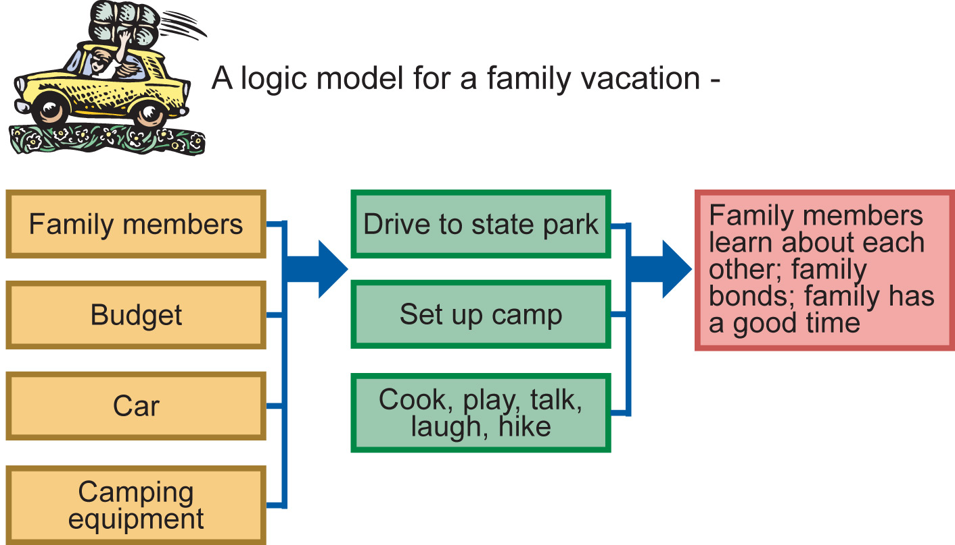
What is a Logic Model?
Notes:
Whether we realize it or not we are logic modeling all the time.
Logic models can be applied to almost anything we do or are engaged in.
It is just putting ‘structure’ to a way of thinking…a graphic representation of our mental processes that focus on achieving outcomes.

Slide 21
What is a Logic Model?
A picture of your program. Graphic and text that illustrates the causal relationship between your program’s activities and its intended results.
To produce these outputs…
So that participants change their behaviors in the following ways…
We use these resources…
For these activities…
Leading to this program result!
Notes:
Participants should have taken the WBT and completed a logic model (to the extent possible) for their LDP.

Slide 22
5 USC 4101—Definition of Training
“training” means the process of providing for and making available to an employee, and placing or enrolling the employee in, a planned, prepared, and coordinated program, course, curriculum, subject, system, or routine of instruction or education, in scientific, professional, technical, mechanical, trade, clerical, fiscal, administrative, or other fields which will improve individual and organizational performance and assist in achieving the agency’s mission and performance goals;
Notes:
Training clearly serves a specific purpose for the individual AND the organization

Slide 23
Levels of Evaluation
Did it
matter?
Did they like it?
Did they learn it?
Did they use it?

Slide 24
Level 1— Did they like it?
Training → Reactions → Learning → Behavior → Results
Know how the trainees felt about the training event.
Point out content areas that trainees felt were missing from the training event.
Tell how engaged the trainees felt by the training event.
Formative evaluation
Notes:
A level one evaluation is a formative evaluation or a method for judging the worth of a program while the program activities are forming (in progress). Typically referred to as “smile sheets”, this part of the evaluation focuses on the process. Process evaluations permit the designers, learners, and instructors to monitor how well the instructional goals and objectives are being met.

Slide 25
Importance of Level 1
Positive attitudes toward the training can be quite beneficial to ensuring positive level 2 and level 3 outcomes
Evaluation of specific aspects of the training provides import information about what can be improved (instructor, topics, presentation style, schedule, audio visuals, etc.)
Notes:
Learning (Level two outcomes) and transfer of learning (Level three outcomes) are unlikely to occur unless participants have positive attitudes toward the training program. Therefore, it is important to determine participants’ reactions to the training program. Also, positive reactions are important because managers are more likely to eliminate unpopular training programs. Finally, the measurement of specific aspects of the training program can provide important information about what aspects of the training program can be improved in the future.

Slide 26
Level 2 — Did they learn it?
Training → Reactions → Learning → Behavior → Results
Demonstrates participant learning (Pre and Post test)
Formative evaluation
Notes:
Level 2 evaluation is also a formative evaluation that evaluates the process.

Slide 27
Importance of Level 2
Helps promote the development program.
Positive level two evaluation can help in interpreting the results of level three evaluation (e.g., if level three results do not occur, it may due to work place factors and not because of any flaw in the training).
Can provide formative evaluation information that can be used to improve the training (e.g., you may find certain learning objectives that are not being met).

Slide 28
True or False?
If participants are happy or satisfied at the end of a training course, it usually means they will use the skills that they’ve learned.

Slide 29
False
Research indicates there is no significant relationship between:
- perceptions of enjoyment of a training and performance
- perceptions of the instructor’s effectiveness and performance
- perceptions of the amount learned and performance
Notes:
We have to be deliberate and strategic about transfer of learning and not assume that a “good” training will automatically result in improved performance. It’s not just the learning of new skills that produces better outcomes, it is the transfer of that learning into more effective and efficient performance that ensures success.

Slide 30
Levels 3 and 4
Level 3—Did they use it
Level 4—Did it matter
To Be Continued…

Slide 31
Training Effectiveness

Slide 32
Level 4 Overview: Kirkpatrick Business Partnership Model
Notes:
This model begins with level 4 which is where we will begin

Slide 33

National Museums Agency (NMA) Leadership Development Program
Notes:
Field Guide Scenario

Slide 34
NMA Strategic Goals
Build and maintain a strong agency leadership pipeline and talent pool for leadership continuity and viability
Develop future leaders who are ready to step into higher positions
Enhance and grow and strong pan-institutional leadership team

Slide 35
Situation
a front-page expose of funds misuse by one museum director, reduced donations and lack of a consistent succession plan across the organization. Finally, there was an apparent lack of pan-institutional cooperation among the museums. Competition between museums had reached a level that surpassed friendly competition.
Does anyone want to share the situation that was/is the catalyst for your LDP?
Notes:
Can be a problem or an opportunity. Either way we want to realize measurable results.

Slide 36
Level 4 — Did it matter?
Training → Reactions → Learning → Behavior → Results
Level four outcomes tend to fall far down outcome lines, which means that many intervening factors must take place in order for the level four outcomes to take place.
Connect the training program to a larger organizational strategic program that is designed to produce level four changes.
Notes:
Whenever possible, try to align your training program with your agency priority goals to give the program more credibility and demonstrate its value. Keep in mind that while training certainly contributes to Level 4 outcomes other forces outside of training will impact whether or not you accomplish level 4 results. This is why we begin with the Strategic goal aligned with your program.

Slide 37
NMA: Level 4 Business Need
Business Need
• Maximize and demonstrate impact from donations.
• Create leadership pipeline for sustained institutional success.
• Build a pan-institutional culture where decisions are made with the betterment of the entire NMA in mind.

Slide 38
Level 4: Pitfalls to Avoid
Pitfalls to Avoid
• Creating a training program without first identifying stakeholders that will judge its success
• Trying to please everyone instead of identifying the few, most critical group of stakeholders that need to be satisfied
Assuming that business/organizational leaders have expectations and targeted results in mind when they make a training request

Slide 39

Level 4: How to Avoid the Pitfalls
Get Involved
Obtain leadership support

Slide 40
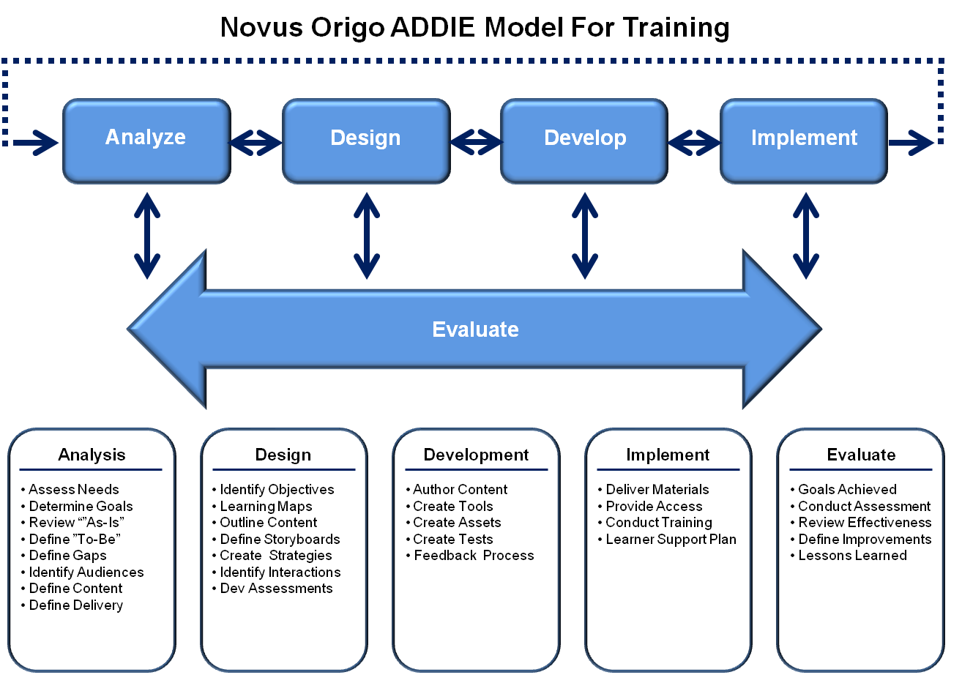
Get Involved: ADDIE Model
Notes:
If the training is created in-house (by an employee or contractor) PMs can become involved in the various phases of the Addie model by working with the ISD professional in creating the course materials or they can require the ISD professional use the ADDiIE model when designing the training.

Slide 41
What is ADDIE?
A systematic approach (model) for developing effective instruction.
One of the most popular models in instructional design.
Outcome of each step feeds into the subsequent step.
Evaluation is ongoing throughout each layer of design.

Slide 42
Get Involved: Effective Learning Interventions for Developing ECQs
Notes:
Empirically based report specifying the best learning interventions for all competencies in the ECQs. See Handout

Slide 43
OPM Leadership Development Matrix
Adapted from the Draft OPM document Effective Learning Interventions for Developing ECQs
A Quick reference guide that highlights the most effective and targeted approach for developing each competency within the ECQs

Slide 44
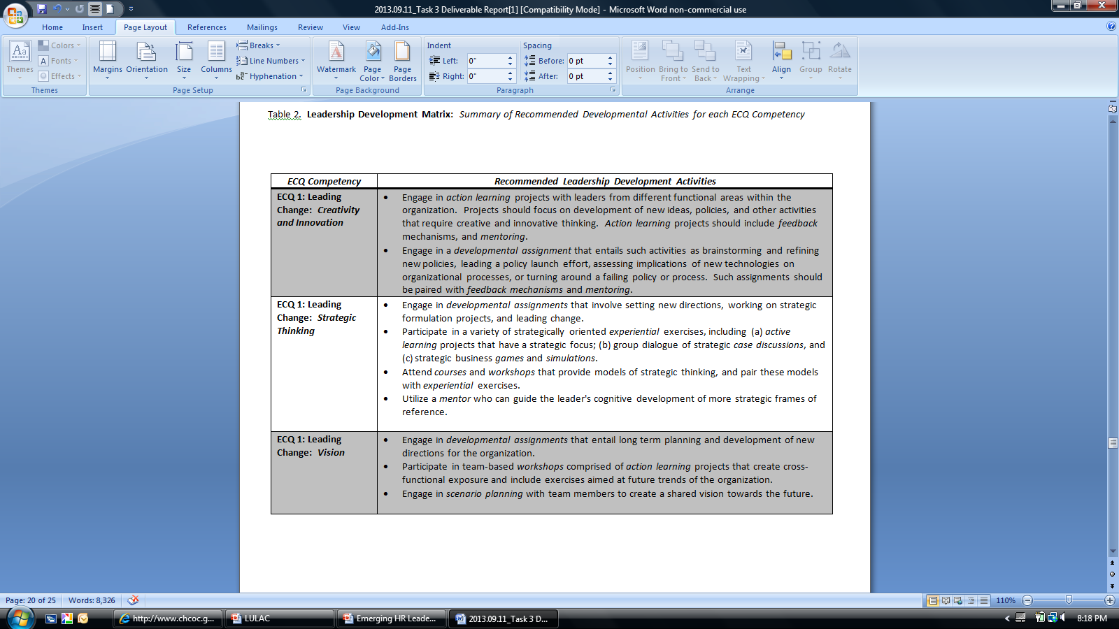
Example: Leading Change
Notes:
For training that has already been created, the PM can use the Leadership Development Matrix to ensure the training can help effectively close competency gaps identified by program participants

Slide 45
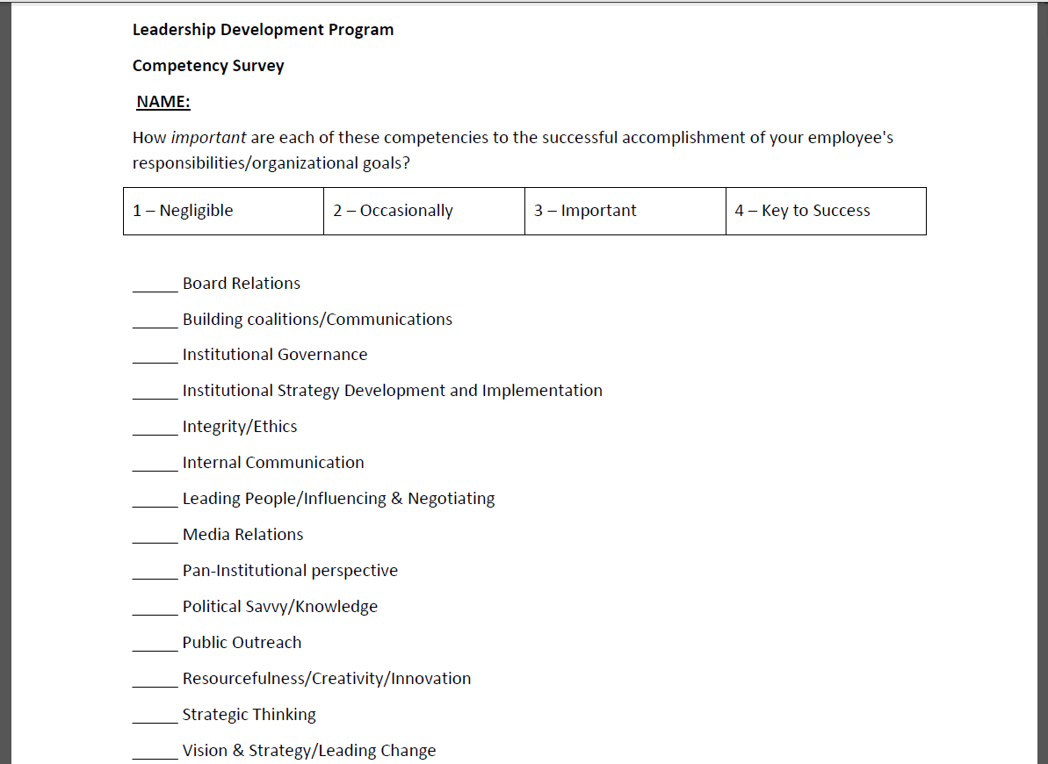
Obtain Leadership Support: Get Stakeholders Involved in the Training
Notes:
May be used in the analysis phase of ADDIE

Slide 46
Stakeholder Engagement
Benefits for the Training Department | Benefits for the Stakeholder
Streamlined policy and program development processes | Greater opportunities to contribute directly to development of training
Increased efficiency in and effectiveness of training delivery | More open and transparent lines of communication – increasing the accountability of Government and driving innovation
Improved risk management practices – allowing risks to be identified and considered earlier, thereby reducing future costs | Improved access to decision-making processes, resulting in the delivery of more efficient and responsive training
Enhanced organizational confidence in the training department | More effective training department
Notes:
There are benefits to engagement for the training department and for the stakeholders involved.

Slide 47
Activity: Stakeholder Map
Draw and label the Stakeholders who are invested in the accomplishment of your Level 4 results.
Draw lines with arrows connecting stakeholders.
Write a label on the line to describe relationships.
How can you inform these stakeholders of the strategic role your leadership development program plays in accomplishment of that goal?
Notes:
Stakeholder Map activity

Slide 48
Activities: Training Effectiveness
Level 4 Planning: Identify the program results and measures
Level 3 Planning: Identify critical behaviors and leading indicators
Notes:
Now we are going to write the results and measures for your agency’s leadership development program.
Four types of measures:
-Quality
-Timeliness
-Quantity

Slide 49
NMA Results and Measures
Level 4 Result
To sustain the ability of the NMA to share knowledge with the world.
Level 4 measurement (observable, measurable)
The sustainment of the NMA would be measured in two ways:
1. Donation levels
2. Cross-organizational agreement on funding usage

Slide 50
Level 4 Activity: Identify the Program Outcomes and Measures
Input (Resources) | Activity (What you do) | Output (Level 1 & 2) | Behaviors (Level 3) | Outcomes (Level 4)

Slide 51
Sample Succession Planning Results
To increase the organization’s ability to fill key jobs with internal candidates
To sustain diversity in promotions
To increase positive performance evaluations
To maintain leadership effectiveness
To increase high potential retention & attrition
How will you collect data to verify that you’ve accomplished these results?

Slide 52
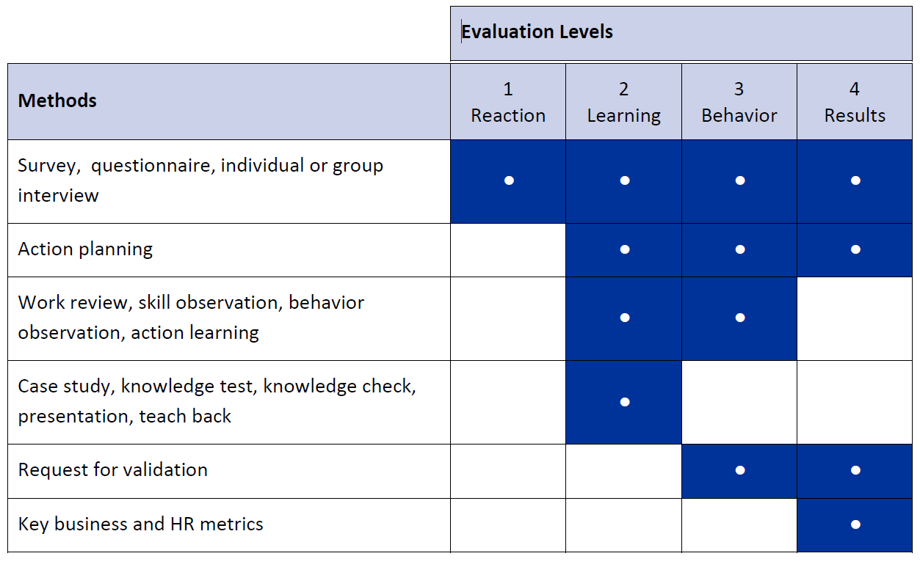
Data Collection Methods (pg. 31 & 32)
Notes:
Action Planning: Training participants create a plan that they commit to enact when training is complete. Ideally a supervisor follows up on the plan and provides coaching support and reinforcement.

Slide 53
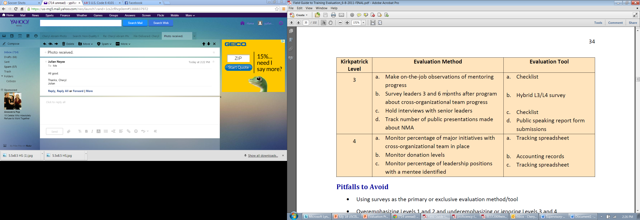
NMA Data Collection Methods

Slide 54
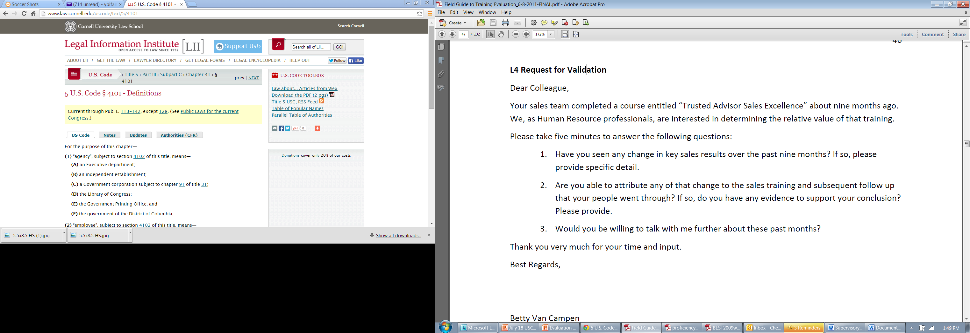
Sample Level 4 Method

Slide 55
Level 3 Overview— Did they use it?
Program → Reactions → Learning → Behavior → Results
Measures actual behavior on the job, rather than only measuring or demonstrating positive reaction, learning or intent to apply the learning.
Level three outcomes are required for level four outcomes
Sometimes, evidence of level 1 outcomes, level 2 outcomes, and level 3 outcomes will be sufficient evidence of the merit and usefulness of a training program.
Notes:
Level 3 is about putting ideas and concepts to work in solving problems. You can only measure behavior when the individual is back on the job and has had an opportunity to use the skill and competencies learned during training. You can greatly increase transfer of skills back to the job with the use of “drivers” or activities that support and re-enforce the transfer of the learning (e.g. mentoring, rewards, job aids)

Slide 56
The Fun Theory
https://www.youtube.com/watch?v=2lXh2n0aPyw
Notes:
Show video

Slide 57
Training Transfer
Before
During
After
Notes:
Provide the draft TTMatrix as a job aid

Slide 58
GROUP 2
12 supervisors report a 15% decrease in the amount of time they spend making “unnecessary” edits to reports written by those who attended the course;. supervisors attribute half of this improvement to training.
Saved 22 “man-hours” (valued at $10,437). participants report a 40% decrease in the number of final drafts returned to them, by supervisors for additional edits.
70% of supervisors report more positive feedback from end users.
GROUP 1
30 employees completed the course
4.5 of 5.0 satisfaction
95% said they will use what they learned back on the job
Notes:
Something needs to happen from group 1 to become group 2. This “something is “Transfer”.

Slide 59
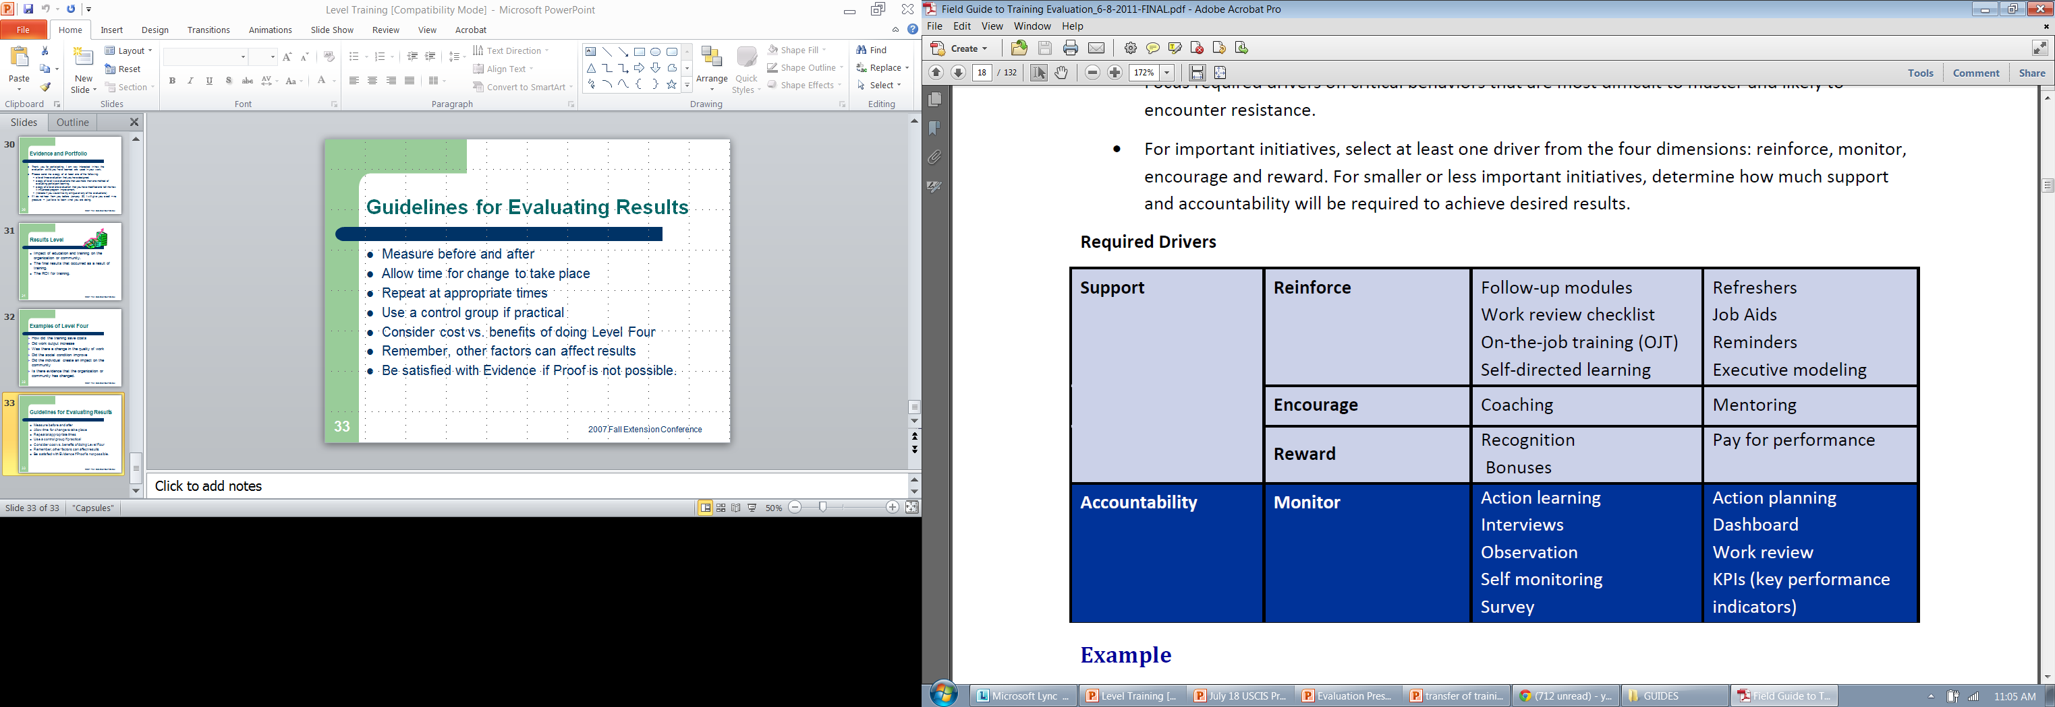
Required Drivers
Notes:
Required drivers should be identified before the training

Slide 60
Level 3:
Determine Critical Behaviors
The degree with which critical behaviors are performed on the job determines the degree to which desired results are obtained.
Purpose
• Define clearly exactly what needs to be done in measurable, observable, quantifiable terms
• Identify the few, critical behaviors that will have the greatest impact on the desired goal and agency mission

Slide 61
Level 3: Identify Leading Indicators
Purpose
• Provide early validation that the correct critical behaviors were selected
• Inform and reassure stakeholders, training professionals and initiative participants that long term targeted results are on track for success

Slide 62
Level 3 Activity
Identifying Critical Behaviors & Leading Indicators
Input (Resources) | Activity (What you do) | Output (Level 1 & 2) | Behaviors (Level 3) | Outcomes (Level 4)

Slide 63
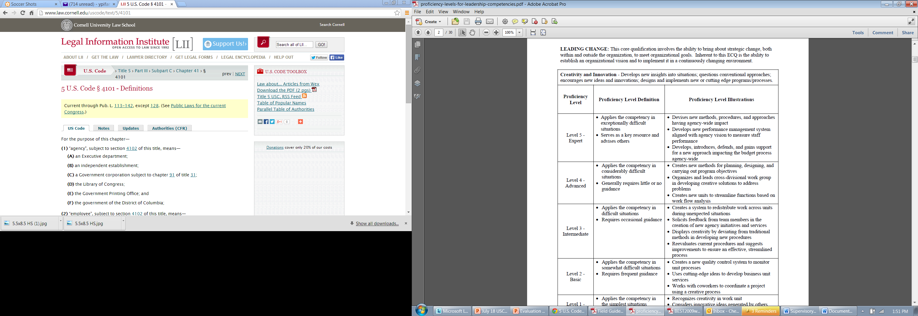
Activity: Identifying Critical Behaviors & Leading Indicators

Slide 64
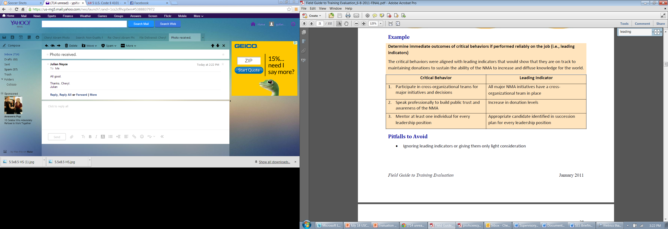
NMA: Critical Behaviors and Leading Indicators

Slide 65
Data Collection Methods (pg. 31 & 32)
Notes:
Action Planning: Training participants create a plan that they commit to enact when training is complete. Ideally a supervisor follows up on the plan and provides coaching support and reinforcement.

Slide 66
Quick Tip: Writing Good Evaluation Questions
Belief
Behavior
Evaluation
Notes:
Belief is about what the participant thinks will happen (Will you use this information?)
Behavior is about what they actually did (how many did you complete?)
Evaluation is about what happened (Did your EVS score increase? Is there a more diverse pool of leaders?)

Slide 67
Action Planning Activity
Now that you’ve created measurable Level 3 and Level 4 outcomes and measurements how will you proceed to effectively evaluate your program at these levels?
  Stakeholder support
  Get involved in the process
  Create relevant questions
  Ensure drivers are in place
Individual action planning
Notes:
Provide action plan

Slide 68
OPM Contacts
Cheryl Ndunguru (Cheryl.Ndunguru@opm.gov)
Yadira Guerrero (Yadira.Guerrero@opm.gov)

